Slide 1


Chukwuemeka Okoli
2nd December 2021

Slide 2

Outline
Executive Summary
Introduction
Methodology
Results
Conclusion
Appendix

Slide 3
Executive Summary
Summary of methodologies
Data Collection through API
Data Collection with Web Scraping
Data Wrangling
Exploratory Data Analysis with SQL
Exploratory Data Analysis with Data Visualization
Interactive Visual Analytics with Folium
Machine Learning Prediction
Summary of all results
Exploratory Data Analysis result
Interactive analytics in screenshots
Predictive Analytics result

Slide 4
Introduction
Project background and context
SpaceX offers Falcon 9 rocket launches on its website for $62 million, whereas other providers charge upwards of $165 million. The primary reason for SpaceX's lower costs is the reusability of the first stage. By predicting the successful landing of the first stage, we can estimate the launch cost. This could be useful for other companies aiming to compete with SpaceX for rocket launches. The objective of this project is to build a machine learning pipeline to predict the successful landing of the first stage.
Problems you want to find answers
What elements influence whether a rocket lands successfully?
The interplay among various factors that affect the success rate of a rocket landing.
What operating conditions must be in place to guarantee a successful landing program?.

Slide 5


Slide 6
Methodology
Executive Summary
Data collection methodology:
Data was collected using SpaceX API and web scraping from Wikipedia.
Perform data wrangling
One-hot encoding was applied to categorical features
Perform exploratory data analysis (EDA) using visualization and SQL
Perform interactive visual analytics using Folium and Plotly Dash
Perform predictive analysis using classification models
How to build, tune, evaluate classification models

Slide 7
Data Collection
Data was gathered through multiple methods.
A GET request to the SpaceX API was used for data collection.
The response content was decoded into JSON format using the `.json()` function.
The JSON data was converted into a pandas DataFrame with `.json_normalize()`.
The data was cleaned, checked for missing values, and filled where necessary.
Web scraping was performed on Wikipedia to obtain Falcon 9 launch records using BeautifulSoup.
Launch records were extracted from an HTML table, parsed, and converted into a pandas DataFrame for future analysis.

Slide 8
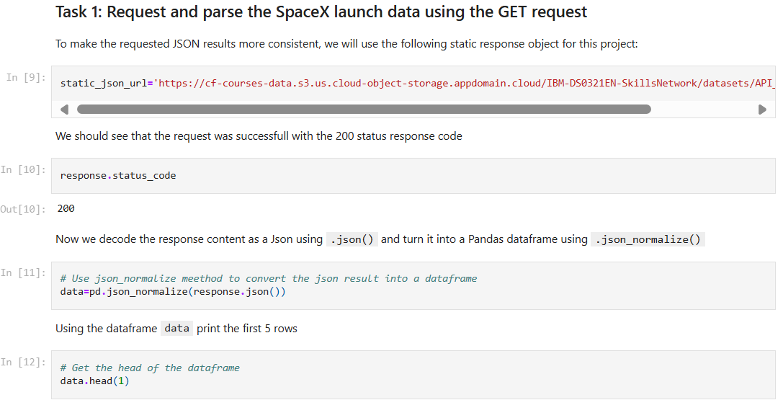
Data Collection – SpaceX API
We utilized a GET request to the SpaceX API to gather data, then cleaned the retrieved data and performed basic data wrangling and formatting.
The link to the notebook is Applied-Data-Science-Capstone/Lab 1 Collecting the Data.ipynb at master · aasimshaikh98/Applied-Data-Science-Capstone (github.com)

Slide 9
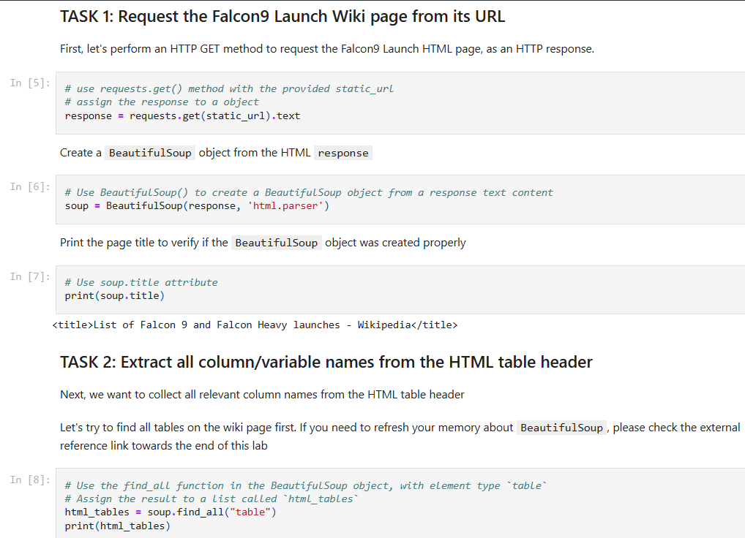
Data Collection - Scraping
We used web scraping to gather Falcon 9 launch records with BeautifulSoup. The data was parsed from the table and converted into a pandas DataFrame.
The link to the notebook is Applied-Data-Science-Capstone/Lab 1 Web Scraping.ipynb at master · aasimshaikh98/Applied-Data-Science-Capstone (github.com)

Slide 10
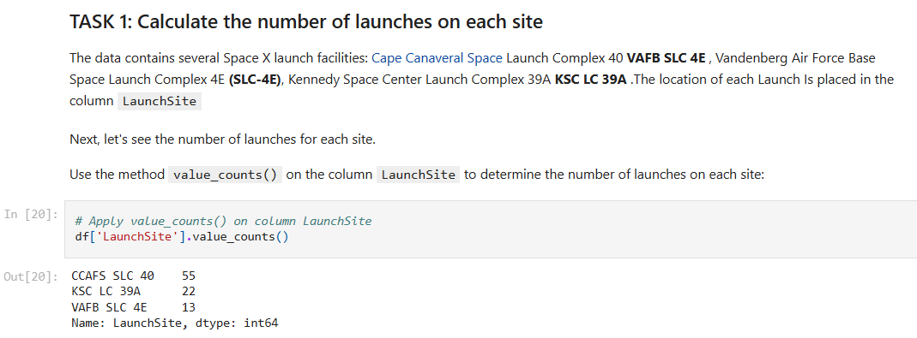
Data Wrangling
We conducted exploratory data analysis and identified the training labels.
We calculated the number of launches at each site and analyzed the frequency and occurrence of each orbit.
Additionally, we generated landing outcome labels from the outcome column and exported the results to a CSV file.
The link to the notebook is Applied-Data-Science-Capstone/Lab 2 Data Wrangling.ipynb at master · aasimshaikh98/Applied-Data-Science-Capstone (github.com)

Slide 11
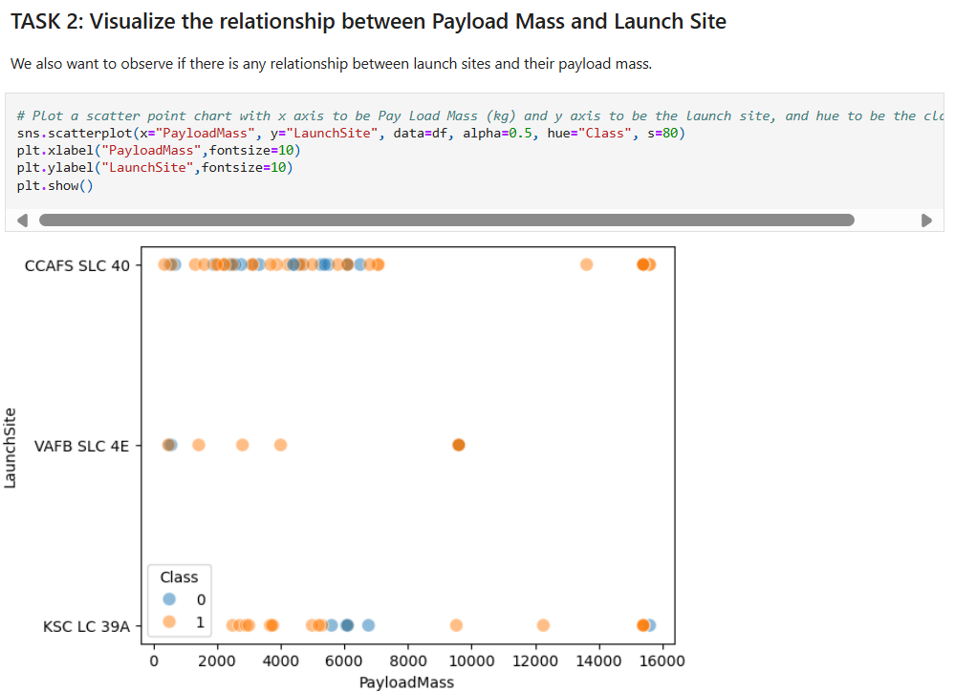
EDA with Data Visualization
We explored the data by visualizing the relationship between flight number and launch Site, payload and launch site, success rate of each orbit type, flight number and orbit type, the launch success yearly trend.
The link to the notebook is Applied-Data-Science-Capstone/Assignment Exploring and Preparing Data.ipynb at master · aasimshaikh98/Applied-Data-Science-Capstone (github.com)

Slide 12
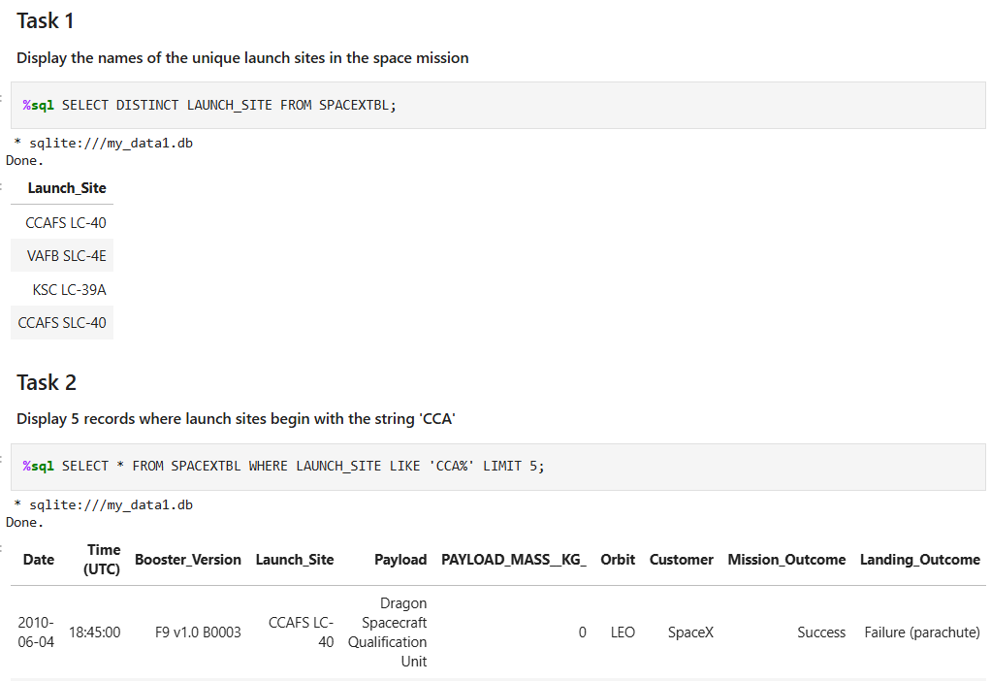
EDA with SQL
We applied EDA with SQL to get insight from the data. We wrote queries to find out for instance:
The names of unique launch sites in the space mission.
Displaying 5 records where launch sites begin with the string ‘CCA’
And many more….
The link to the notebook is Applied-Data-Science-Capstone/Assignment SQL Notebook for Peer Assignment.ipynb at master · aasimshaikh98/Applied-Data-Science-Capstone (github.com)

Slide 13
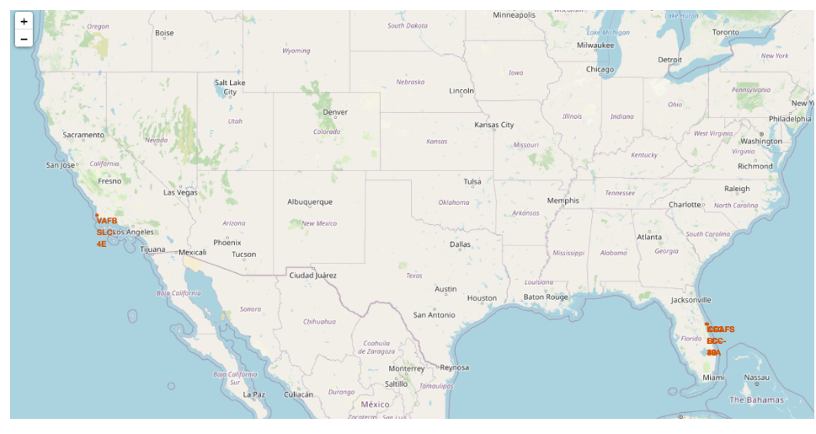
Build an Interactive Map with Folium
We marked all launch sites and added map elements such as markers, circles, and lines to indicate the success or failure of launches at each site on a Folium map.
We assigned launch outcomes as class 0 for failure and class 1 for success. By using color-coded marker clusters, we were able to identify launch sites with relatively high success rates.
The link to the notebook is Applied-Data-Science-Capstone/Launch Sites Location Analysis with Folium.ipynb at master · aasimshaikh98/Applied-Data-Science-Capstone (github.com)

Slide 14
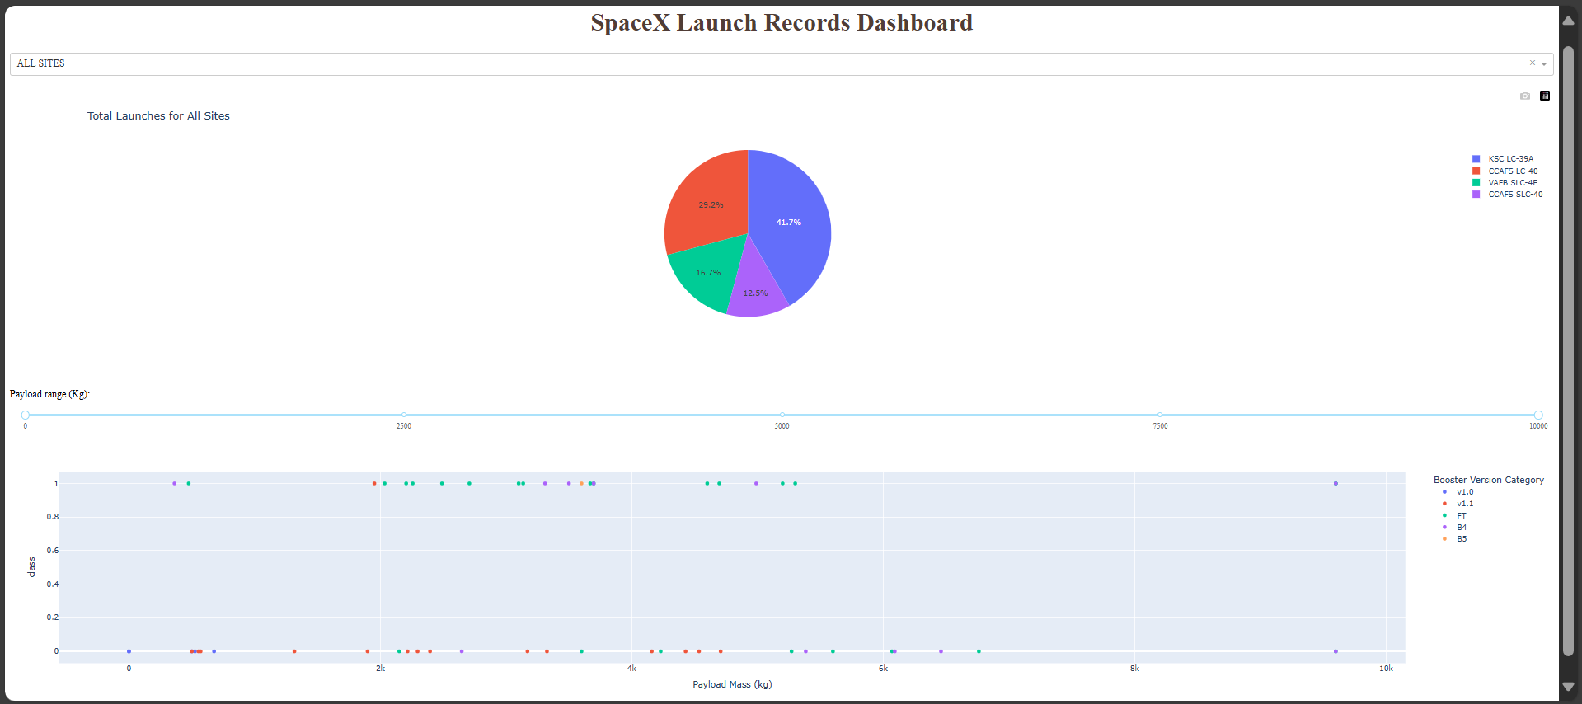
Build a Dashboard with Plotly Dash
We created an interactive dashboard using Plotly Dash.
We displayed pie charts to show the total number of launches by different sites and plotted a scatter graph to illustrate the relationship between launch outcomes and payload mass (in kilograms) for various booster versions.
The link to the python file is Applied-Data-Science-Capstone/Build a Dashboard Application with Plotly Dash.py at master · aasimshaikh98/Applied-Data-Science-Capstone (github.com)

Slide 15
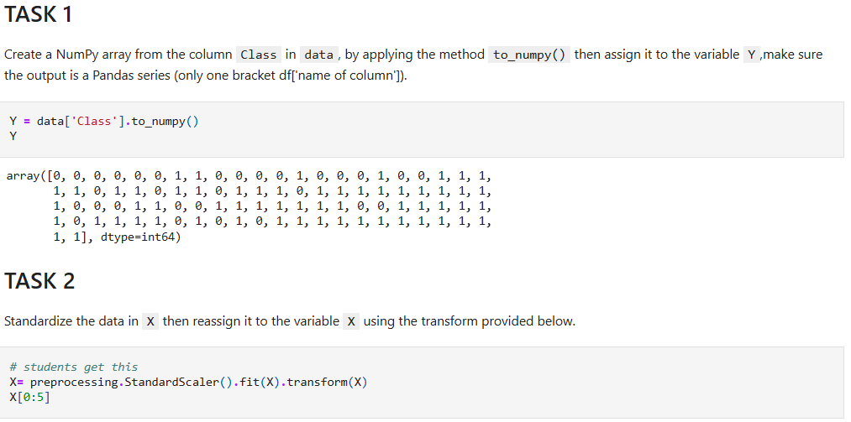
Predictive Analysis (Classification)
We loaded the data using NumPy and pandas, transformed it, and divided it into training and testing sets. We built various machine learning models and fine-tuned hyperparameters using GridSearchCV.
Accuracy was used as the evaluation metric, and we enhanced the model through feature engineering and algorithm tuning. We identified the best-performing classification model.
The link to the notebook is Applied-Data-Science-Capstone/Assignment Machine Learning Prediction.ipynb at master · aasimshaikh98/Applied-Data-Science-Capstone (github.com)

Slide 16
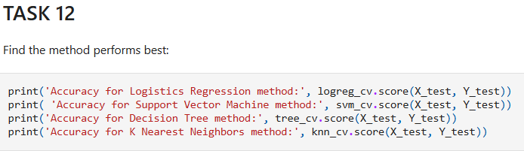
Results
Exploratory data analysis results
Interactive analytics demo in screenshots
Predictive analysis results

Slide 17


Slide 18
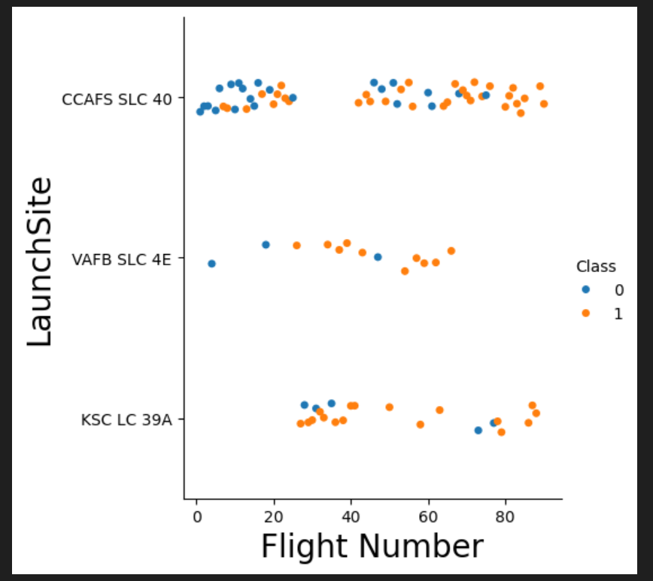
Flight Number vs. Launch Site

Slide 19
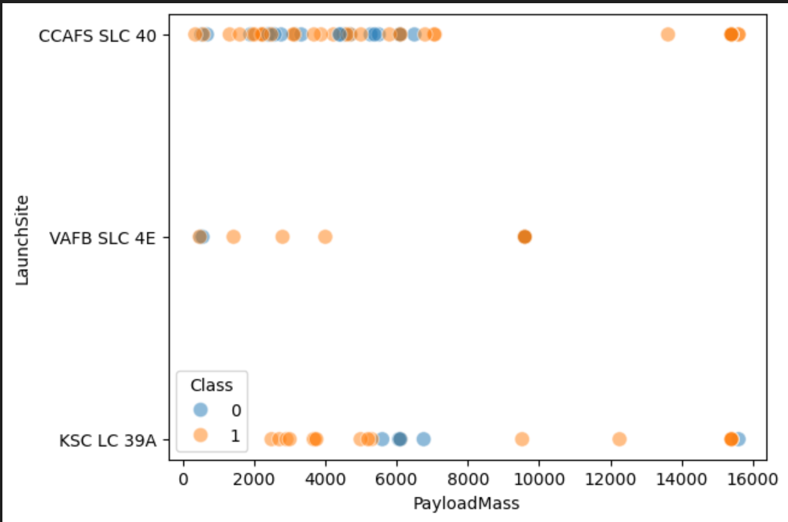
Payload vs. Launch Site

Slide 20
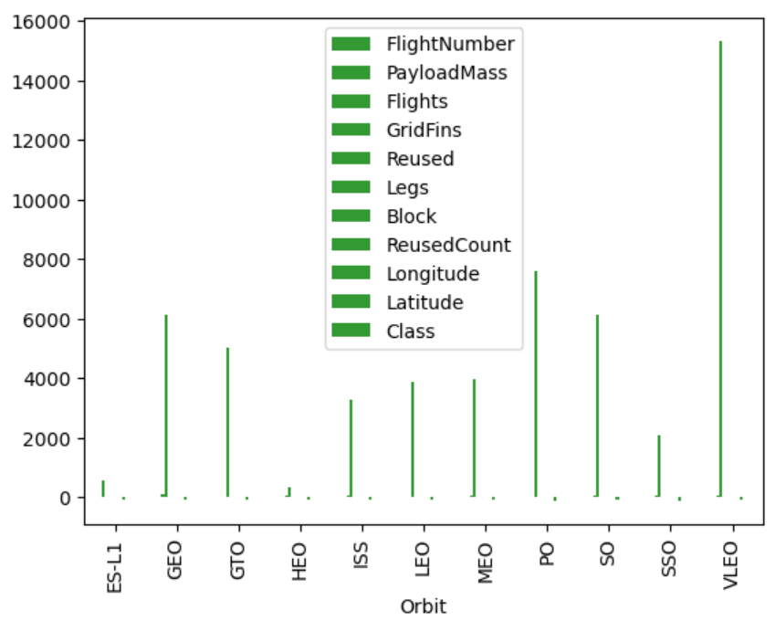
Success Rate vs. Orbit Type

Slide 21
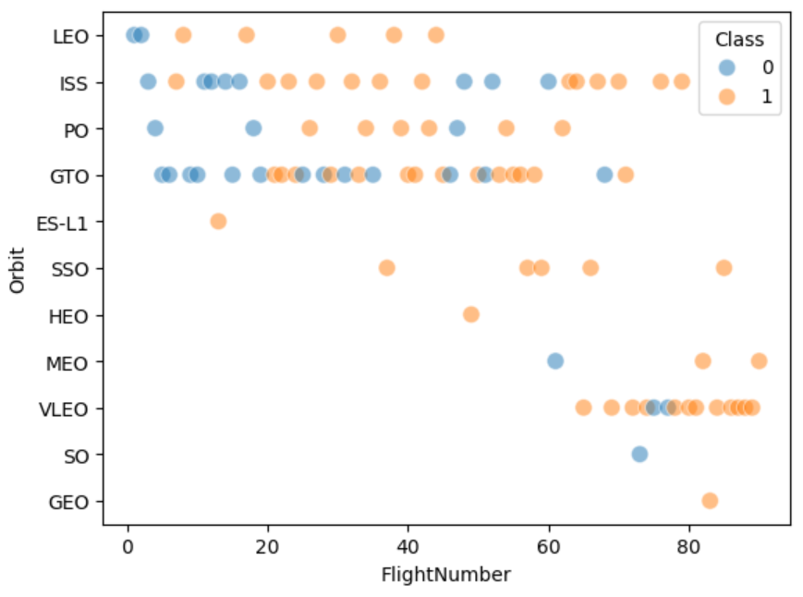
Flight Number vs. Orbit Type

Slide 22
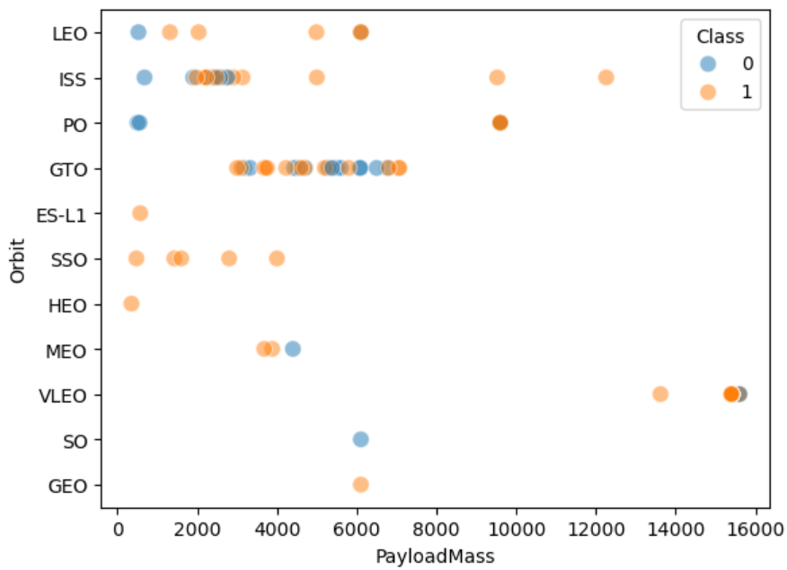
Payload vs. Orbit Type

Slide 23
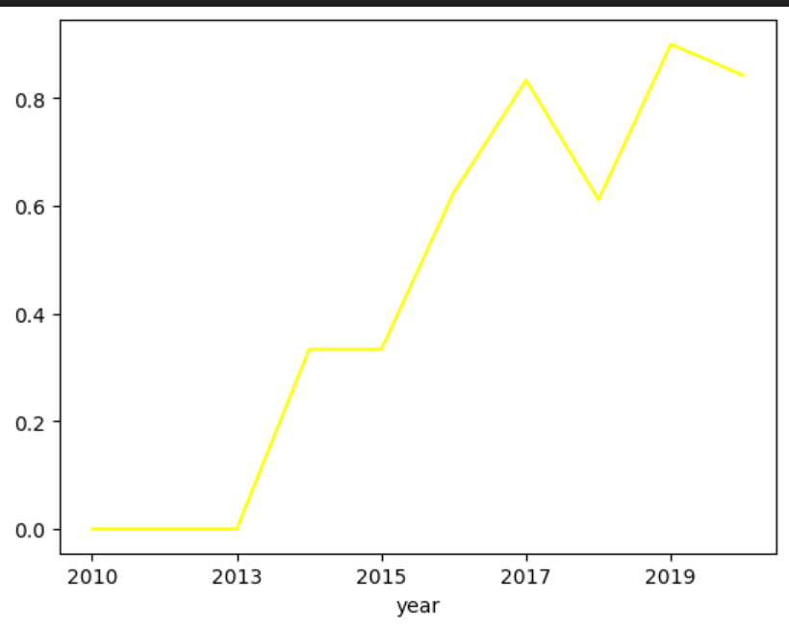
Launch Success Yearly Trend

Slide 24
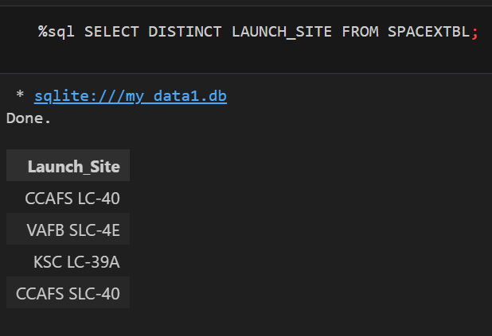
All Launch Site Names

Slide 25
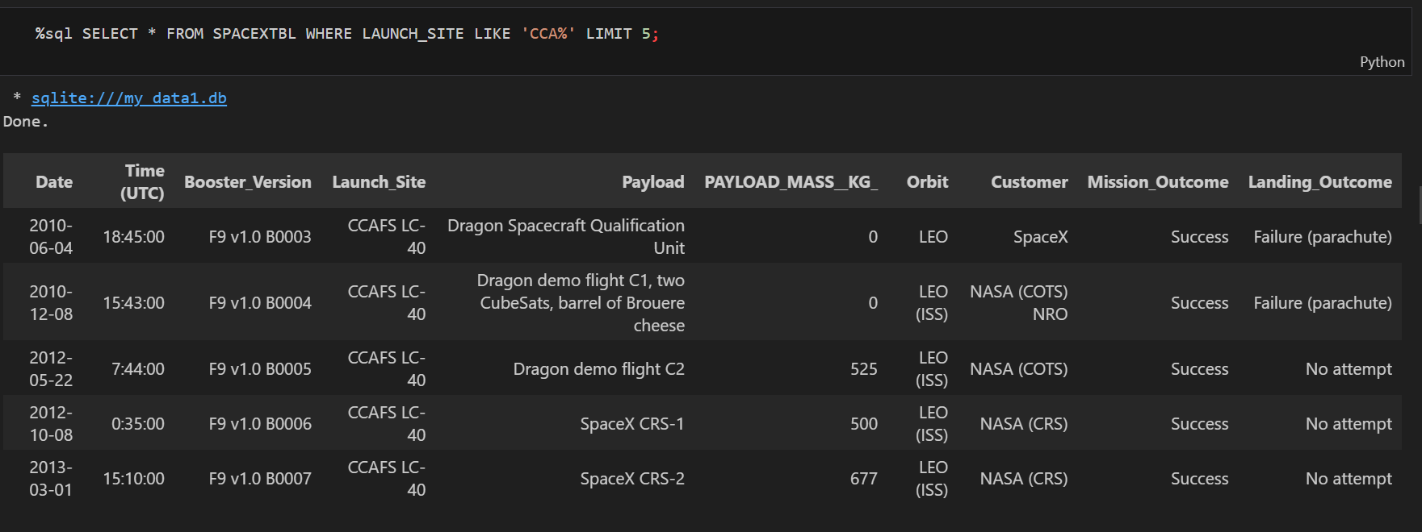
Launch Site Names Begin with 'CCA'

Slide 26
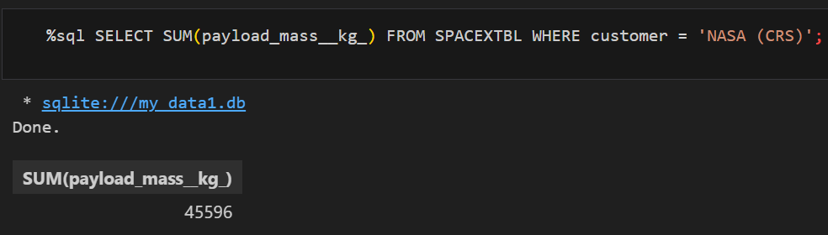
Total Payload Mass

Slide 27
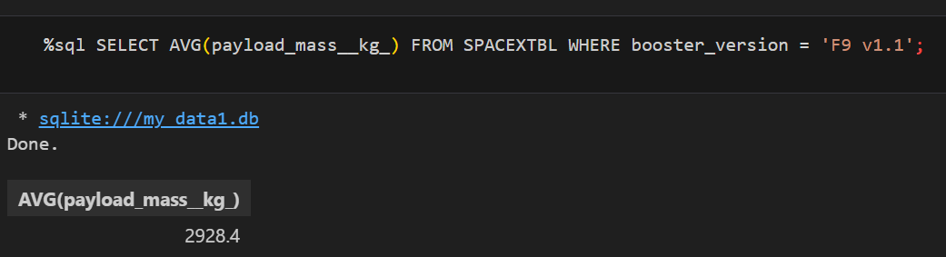
Average Payload Mass by F9 v1.1

Slide 28
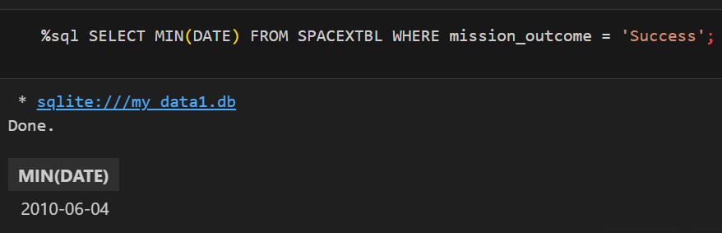
First Successful Ground Landing Date

Slide 29
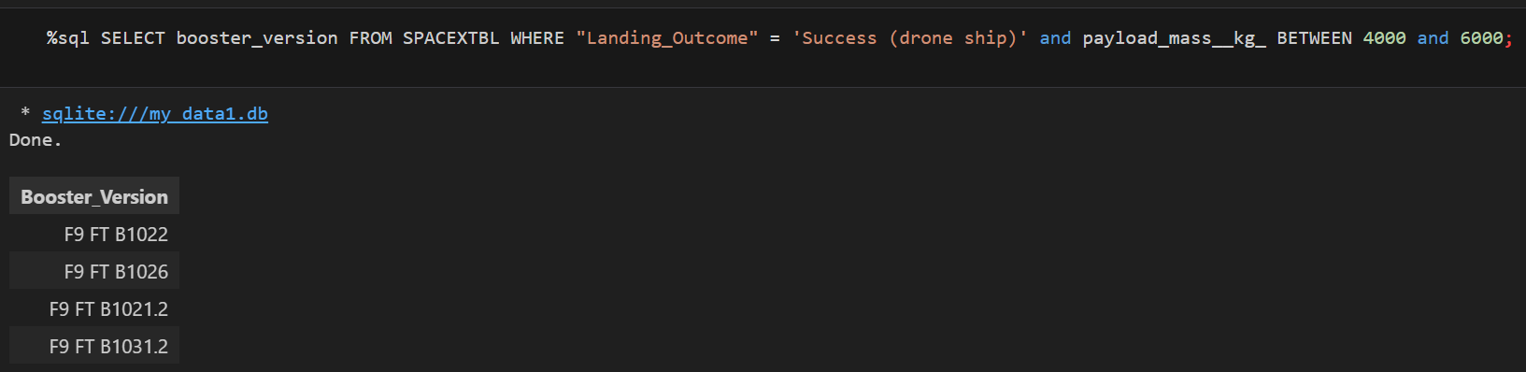
Successful Drone Ship Landing with Payload between 4000 and 6000

Slide 30
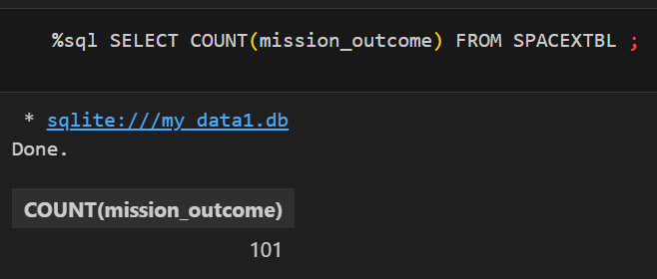
Total Number of Successful and Failure Mission Outcomes

Slide 31
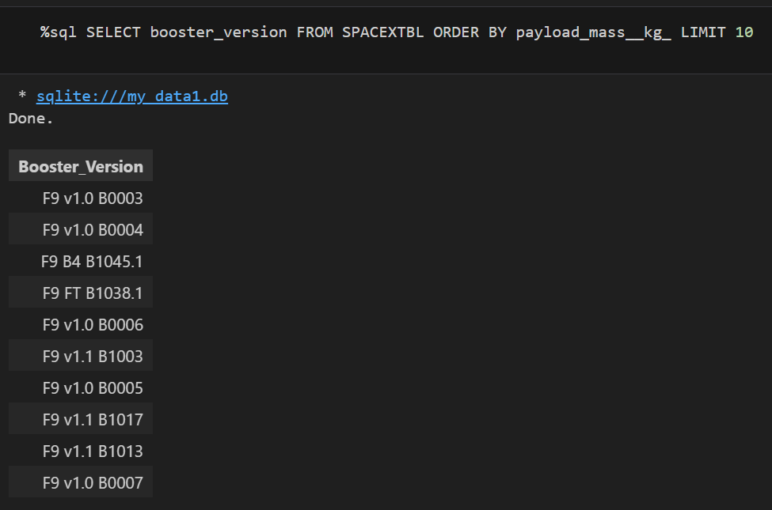
Boosters Carried Maximum Payload

Slide 32
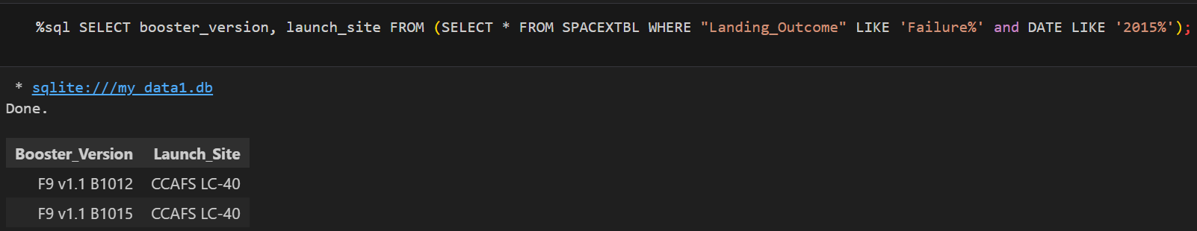
2015 Launch Records

Slide 33
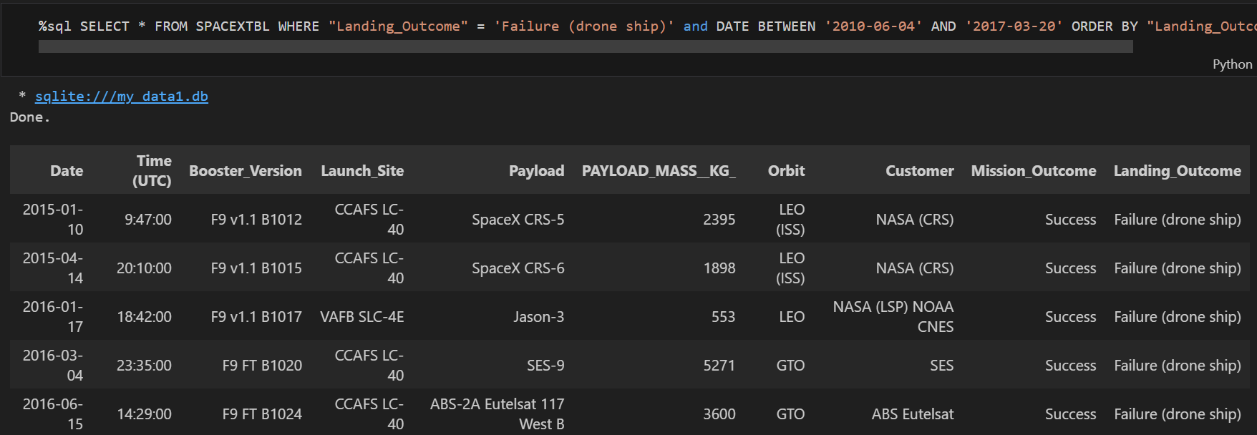
Rank Landing Outcomes Between 2010-06-04 and 2017-03-20

Slide 34


Slide 35
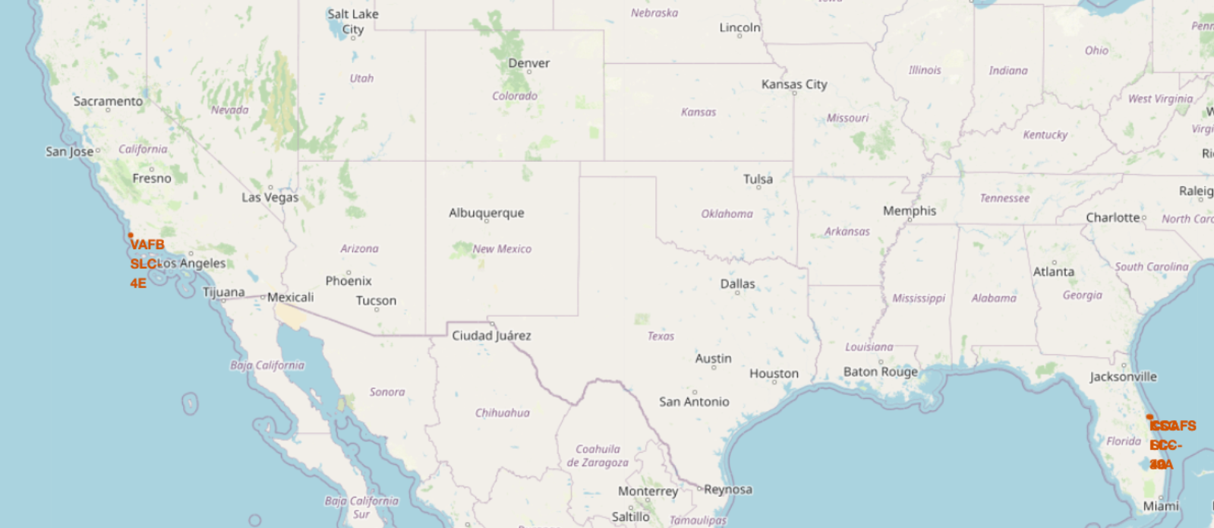
All launch sites global map markers

Slide 36
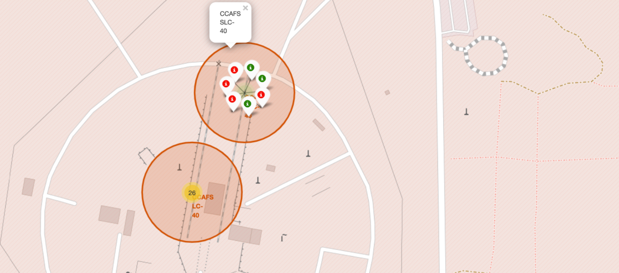
Markers showing launch sites with color labels

Slide 37
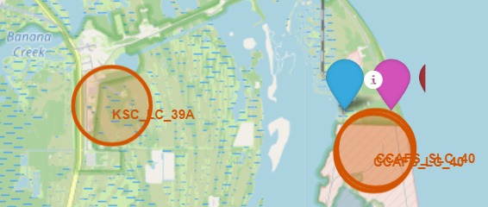
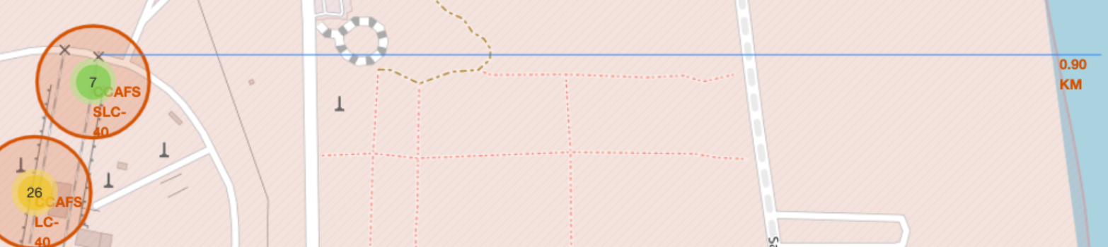
Launch Site distance to landmarks

Slide 38


Slide 39
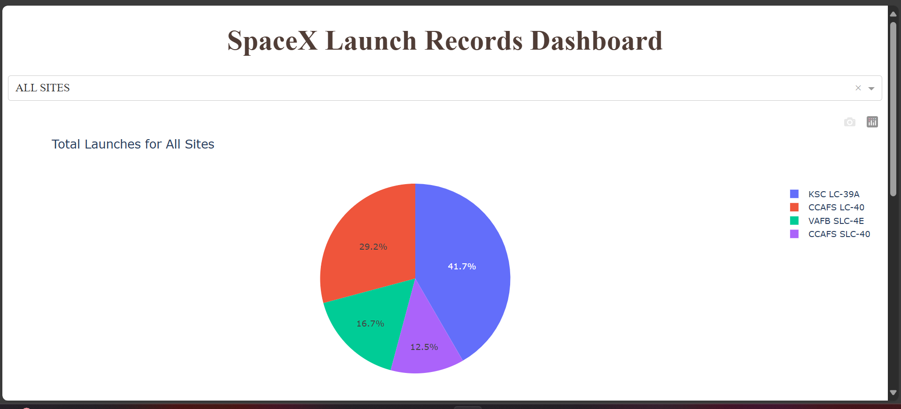
Pie chart showing the success percentage achieved by each launch site

Slide 40

Pie chart showing the Launch site with the highest launch success ratio

Slide 41

Scatter plot of Payload vs Launch Outcome for all sites, with different payload selected in the range slider

Slide 42


Slide 43
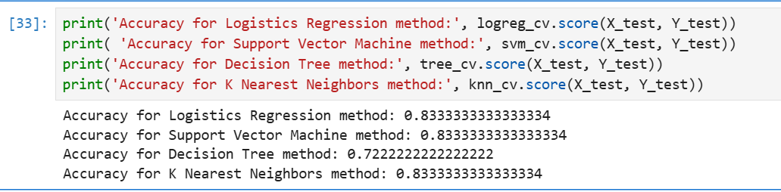
Classification Accuracy

Slide 44
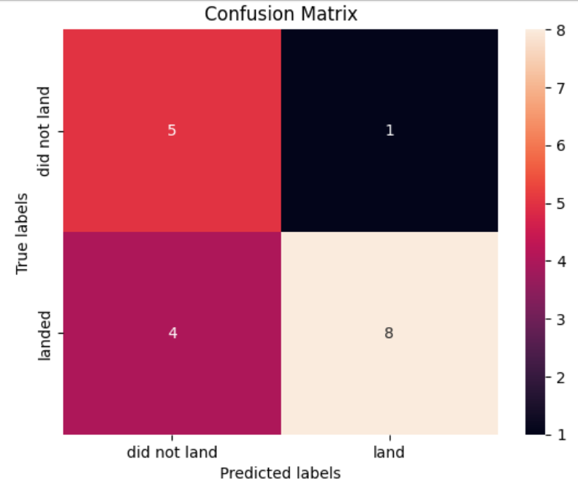
Confusion Matrix
The confusion matrix for the decision tree classifier shows that the classifier can distinguish between the different classes.

Slide 45
Conclusions
We can conclude that:
A higher number of flights at a launch site correlates with a greater success rate at that site.
The launch success rate began to rise from 2013 and continued to improve through 2020.
Orbits such as ES-L1, GEO, HEO, SSO, and VLEO showed the highest success rates.
KSC LC-39A recorded the most successful launches among all sites.
The Decision Tree classifier emerged as the most effective machine learning algorithm for this task.

Slide 46


